Slide 1
2024
Annual Trustees Conference
Productivity Funding Model
March 26, 2024
Blake Cannon
Chief Analytics Officer
Nick Fuller
Assistant Commissioner, Finance

Slide 2
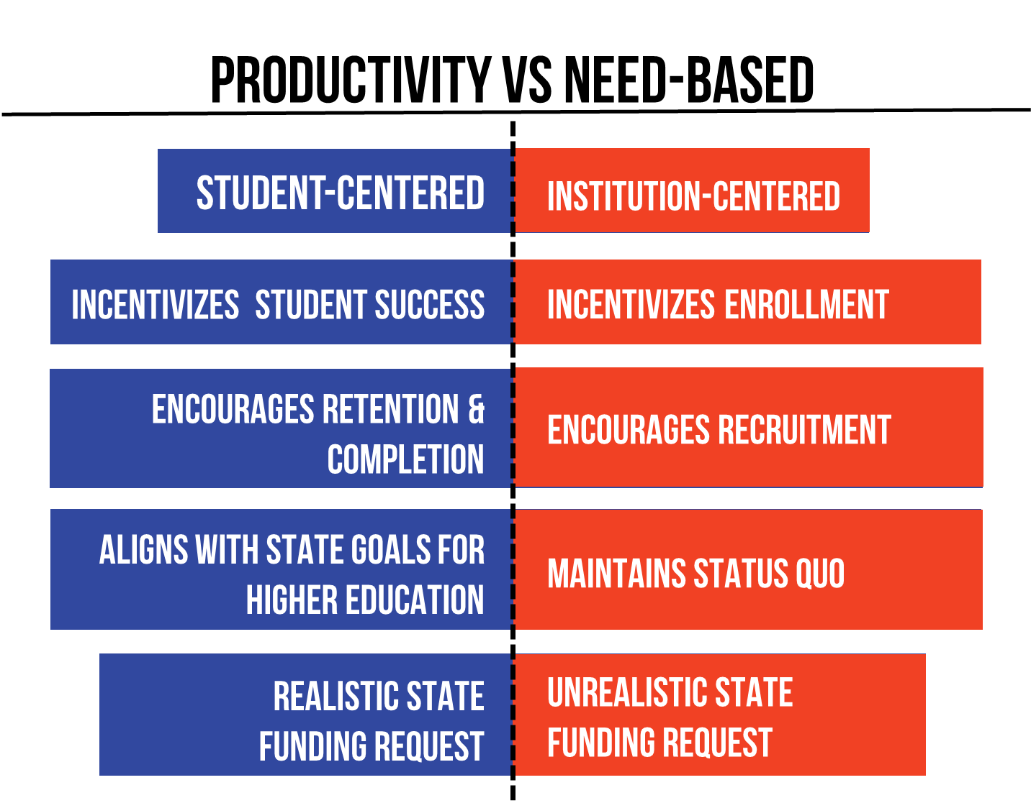
Performance Funding to Productivity Funding
Act 148 was enacted by the 91st General Assembly and was signed into law in February of 2017. The purpose of Act 148 was to adopt a productivity-based funding model for state-supported institutions of higher education.
The major differences between the current Productivity model and the previous Performance (needs-based) model include:

Slide 3
Productivity Funding Workgroup
Workgroup Purpose
  Created rules and guidelines needed to measure and determine the productivity funding model metric scores.
  Meets as needed to review and recommend changes for the model and to address unintended consequences that may be negatively impacting our institutions.
Workgroup is comprised of qualified staff
  Five representatives from our 4-year universities
  Five representatives from our 2-year colleges
  Two representatives from system offices
  Includes Presidents/Chancellors, and leaders from policy, finance, and institutional research
  Currently chaired by Dr. Houston Davis, President of University of Central Arkansas

Slide 4
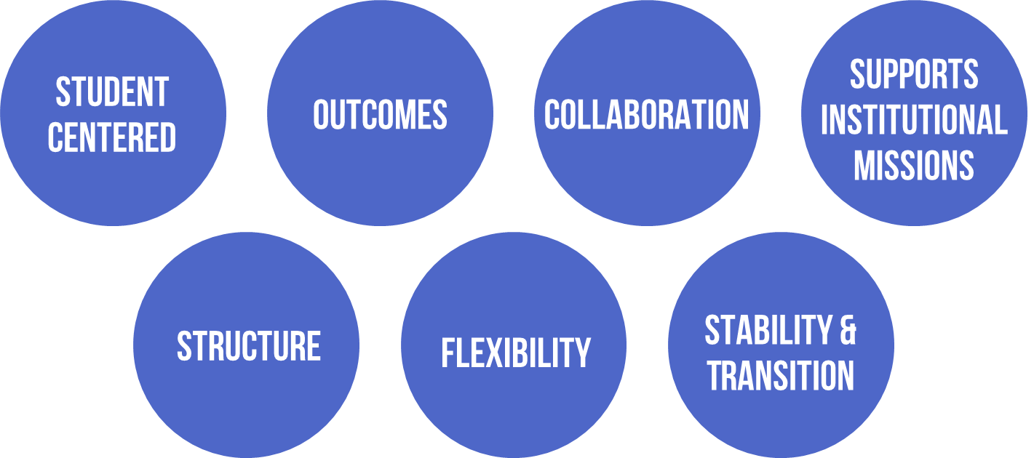
Productivity Funding Guiding Principles
The Productivity Funding Workgroup set out in 2017 to create a model that met the following criteria:

Slide 5
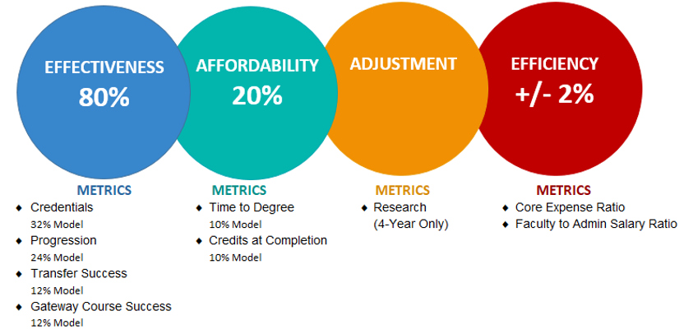
Productivity Funding
4-Year Universities

Slide 6
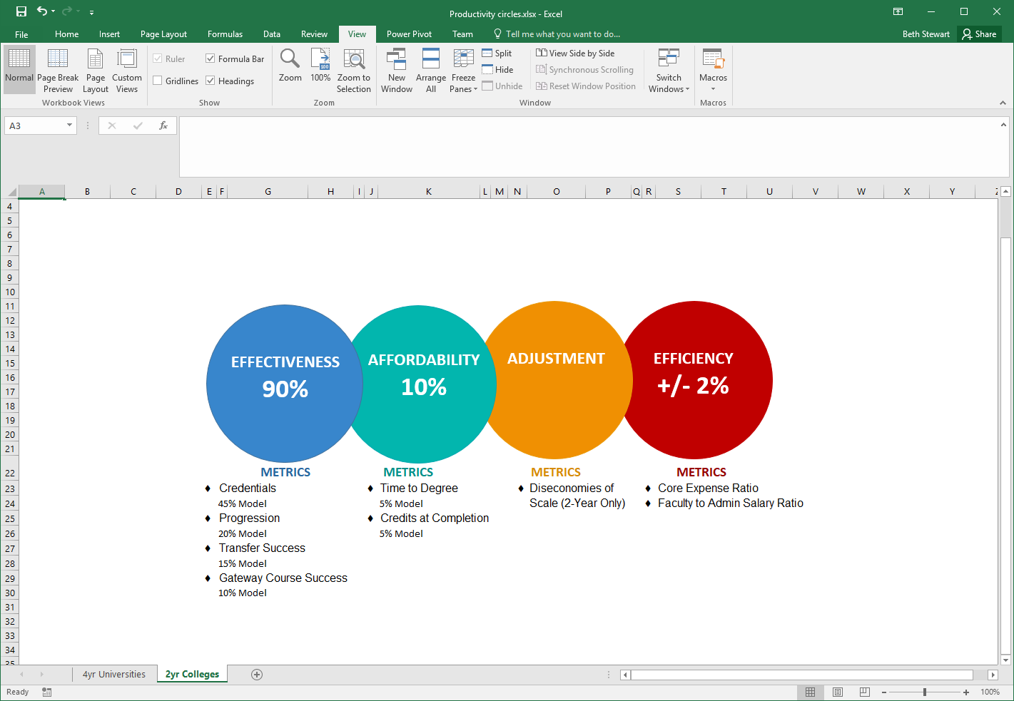
Productivity Funding
2-Year Colleges

Slide 7
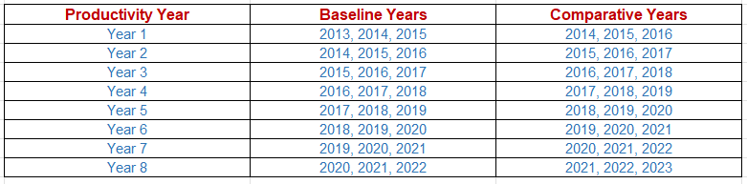
Productivity Funding
An institution’s Productivity is determined by comparing the average of the Baseline years to the average of the Comparative years. An institution is considered productive if their final Comparative score is higher than their Baseline score.
Baseline and Comparative Subsets

Slide 8
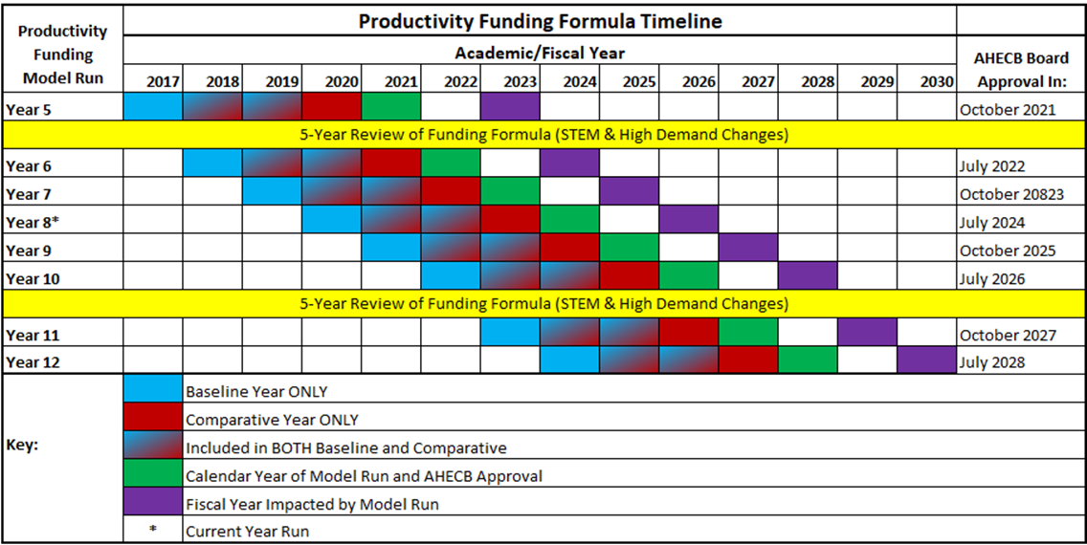
Productivity Funding Timeline

Slide 9
How does this data come together?
ADHE has been collecting data electronically from all public colleges and universities since 1994 and loading into the Arkansas Higher Education Information System (AHEIS). This system provides the majority of the data used in the productivity funding model.
Groups Involved
  Productivity Funding Workgroup, ADHE Data Team, ADHE Academics, ADHE Finance, Campus Institutional Research (IR) Staff and other staff on your campuses that perform the IR functions.
Campus Data Submissions
  IR staff collect and format data utilizing our AHEIS manual.
  Files are submitted electronically and validated.
  Error/warning reports are generated.
    Warnings are especially important for Productivity Funding.
  Submit Institution’s data after a clear error report.
Data Quality Review Process
  Each year, in December, the AHEIS Program Manager, Rachel Lewis, runs a data quality check on all public institutions’ data looking for any data quality issues.
  Multiple spreadsheets containing data questions that could impact their productivity index score are sent to IR staff for review.
  Institution staff have up to two months to review and make any necessary data corrections/changes in AHEIS.

Slide 10
How does this data come together?
Productivity Funding First Run
  Data is pulled from AHEIS to run most metrics of the model.
  Each metric is reviewed by ADHE data team.
  Spreadsheets are distributed to IR staff over each metric for review.
  IR staff review and make necessary corrections.
Productivity Funding Final Run
  Once all updates have been made a final run is done.
  Metric scores are handed off to ADHE Institutional Finance team to prepare the funding model distribution.
  Final Distribution is sent to the Secretary of Education and Governor’s Office for review.
  Final Distribution is sent to Presidents and Chancellors.
  Last step is approval from the Arkansas Higher Education Coordinating Board (AHECB).

Slide 11
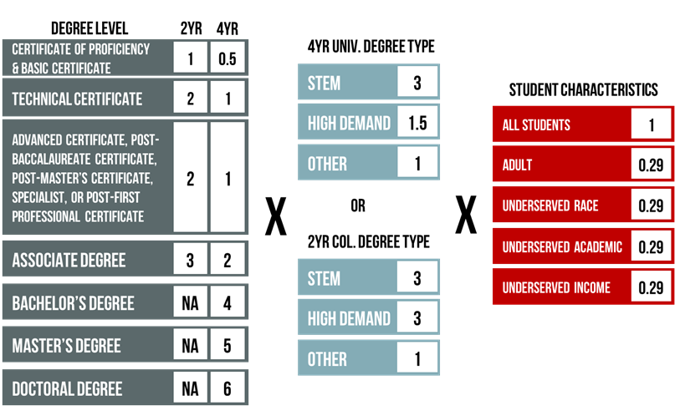
Credentials Metric
In the Credentials metric institutions receive points for all credentials awarded, with multipliers for credentials earned by students who contribute to closing the attainment gap of underserved populations in Arkansas as well as credentials that meet state workforce needs.
2-year Colleges – 45% of model
4-year Universities – 32% of model

Slide 12
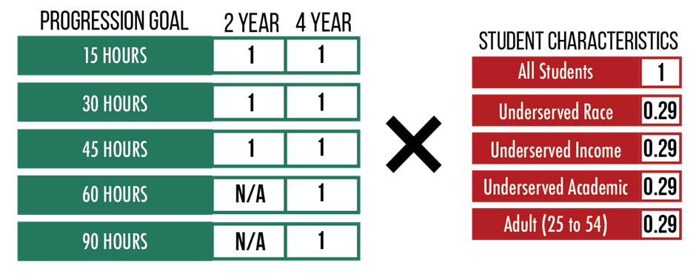
Progression Metric
In the Progression Metric institutions earn points as undergraduate students pass specific Progression goals. The Progression metric involves cross referencing AHEIS data from all public institutions in the state. If the student is identified as an underserved population at any institution at which that student attended for that academic year, the student will be considered underserved for this metric for all institutions.
2-year Colleges – 20% of model
4-year Universities – 24% of model

Slide 13
Transfer Success Metric
The Transfer metric encourages collaboration between Arkansas 2-year colleges and 4-year public and private/independent universities to promote student success.
2-year College (15% of model)
  Associate Degree Awarded
    Graduate with an Associate degree and then enroll as a transfer student at AR 4-year public or private/independent institution within three years.
  30 or more ACTS credit hours
    Earn 30 or more ACTS credit hours then enroll as a transfer student at AR 4-year public or private/independent institution
4-year University (12% of model)
  Student graduated with a Bachelor’s Degree and had transferred from AR public 2-year college within the three years

Slide 14
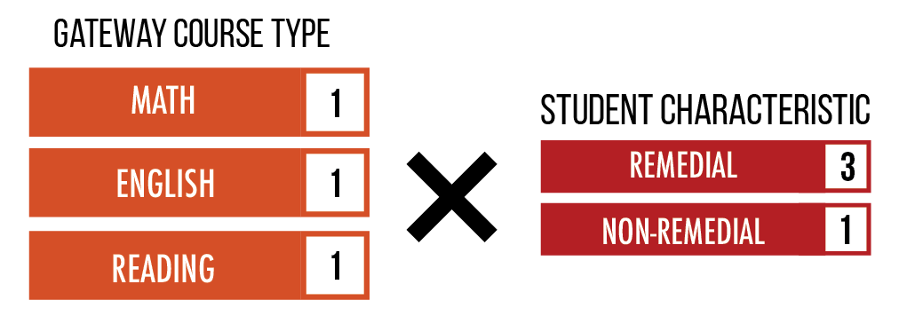
Gateway Course Success Metric
Completion of gateway courses contributes to student progression and degree attainment. Institutions earn points for students successfully completing their first math, English and reading gateway courses. These courses consist of a selection of Arkansas Course Transfer System (ACTS) courses in the specific subject and any exceptions that the institution has cleared through ADHE Academics. Academically underserved students will be weighted more heavily.
2-year Colleges – 10% of model
4-year Universities – 12% of model

Slide 15
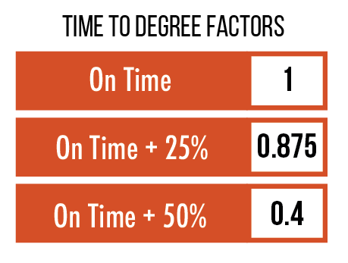
Time to Degree Metric
An average of the number of students who graduated within the recommended timeframe for Associate and Bachelor’s degrees over the most recent three academic years.
2-year Colleges – 5% of model
4-year Universities – 10% of model

Slide 16
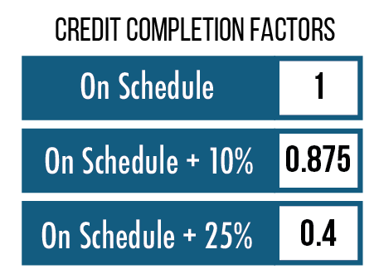
Credits at Completion Metric
An average of the number of students who graduated within the scheduled number of credits completed for Bachelor’s and Associate degrees over the most recent three academic years.
2-year Colleges – 5% of model
4-year Universities – 10% of model

Slide 17
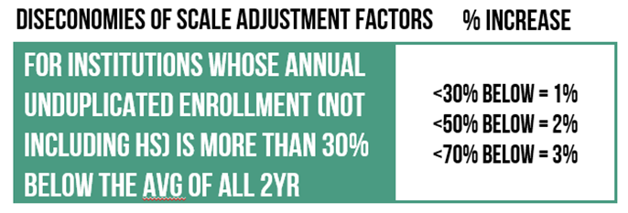
Diseconomies of Scale Adjustment
This adjustment is to recognize that institutions must maintain certain student services regardless of the institution's student enrollment size. This metric increases the index score of a 2-year college that falls into a specified student enrollment size range. The range is based on average three-year enrollment for all 2-year colleges. Data is obtained from IPEDS.

Slide 18
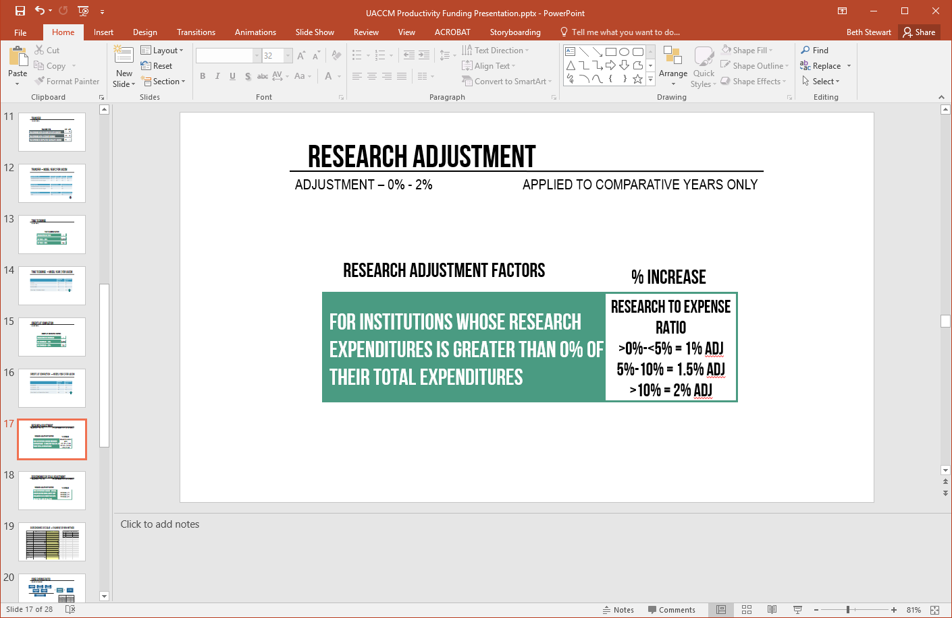
Research Adjustment
Research is essential to the discovery of new knowledge, innovation, entrepreneurism, and societal, health, and economic development advancements. This metric increases the comparative years score of institutions who invest in research by a percentage based on the ratio of research expenditures to total expenditures of the institution as reported on the IPEDS finance survey.

Slide 19
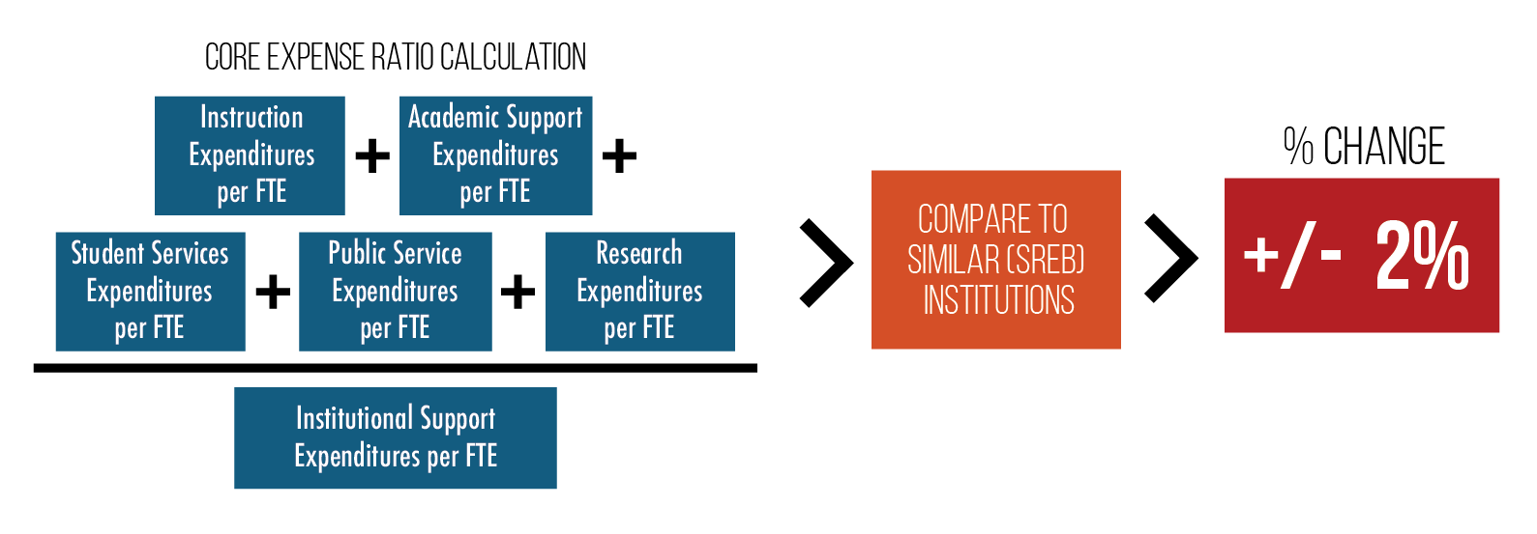
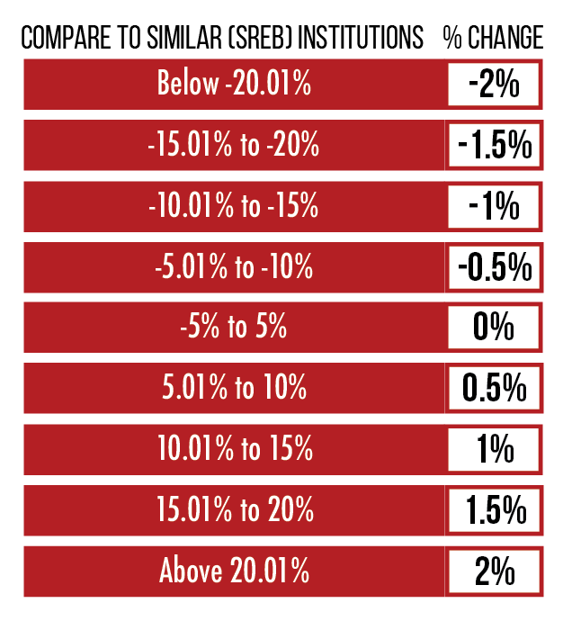
Core Expense Ratio Adjustment
Measures the core expense ratio of each institution as compared to its SREB peer group. Numbers are pulled from the IPEDS Finance Survey.

Slide 20
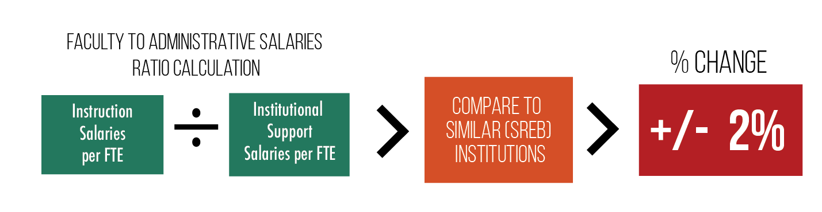
Faculty to Administrative Salary Ratio Adjustment
Measures the ratio of faculty salaries to administrative salaries at an institution as compared to its SREB peer group. Numbers are pulled from the IPEDS Finance Survey.

Slide 21
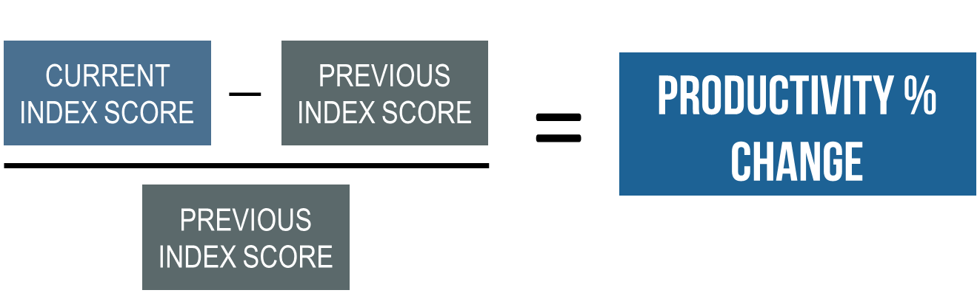
Calculating Productivity Change

Slide 22
Productivity Funding Distribution

Slide 23
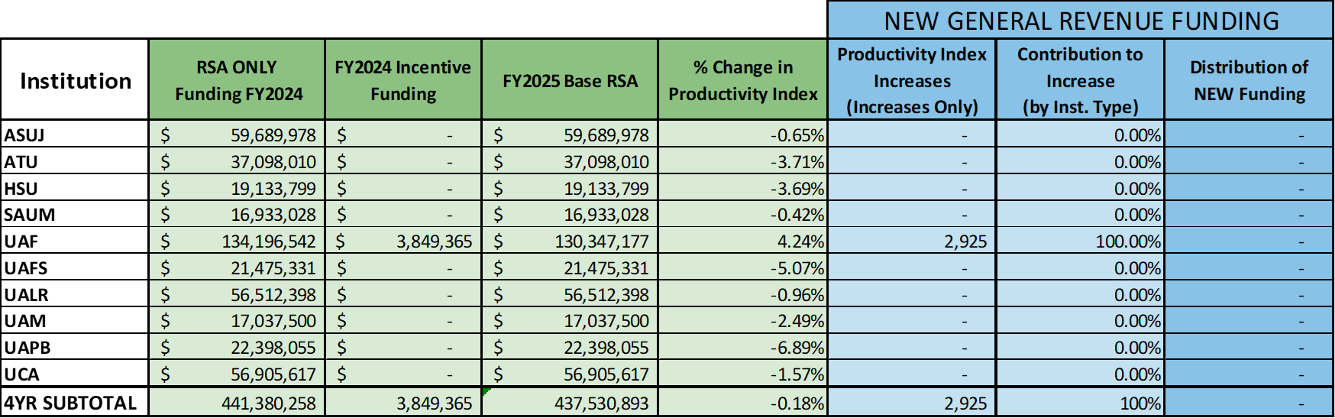
Productivity Funding Distribution
4-Year Universities

Slide 24
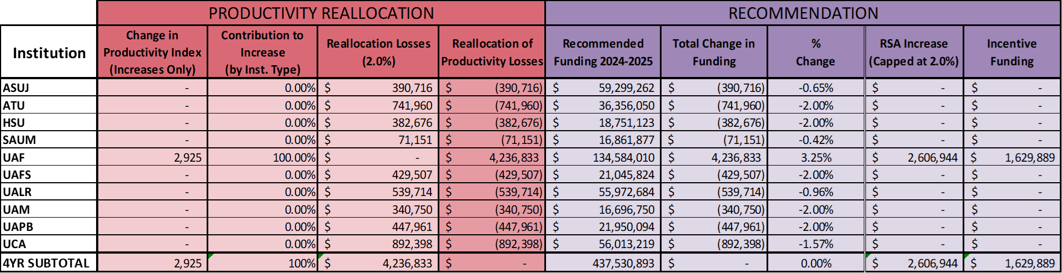
Productivity Funding Distribution
4-Year Universities

Slide 25

Productivity Funding Distribution
2-Year Colleges

Slide 26
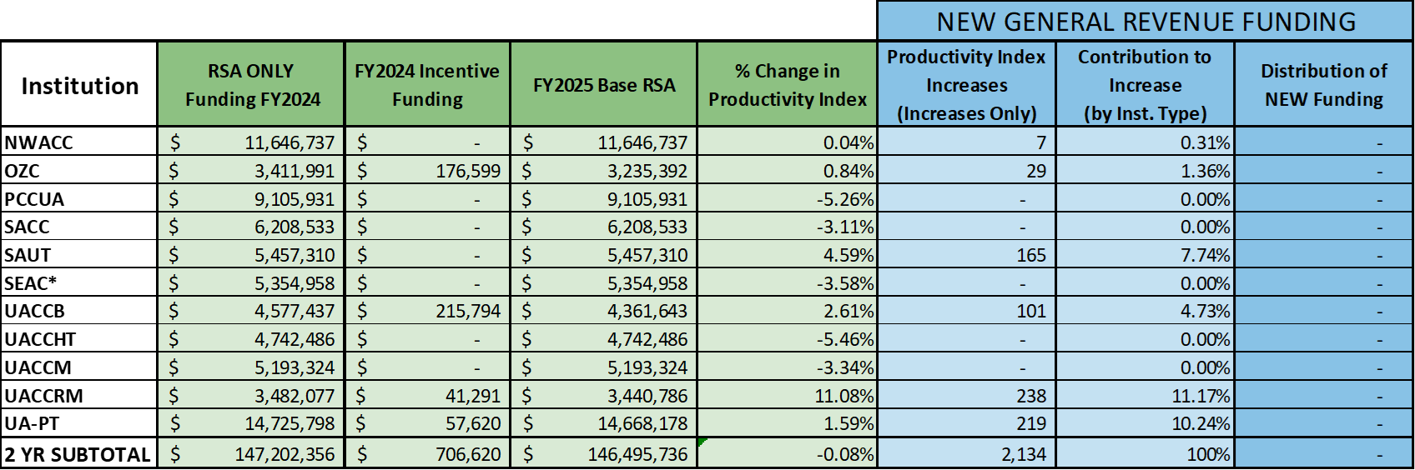
Productivity Funding Distribution
2-Year Colleges

Slide 27
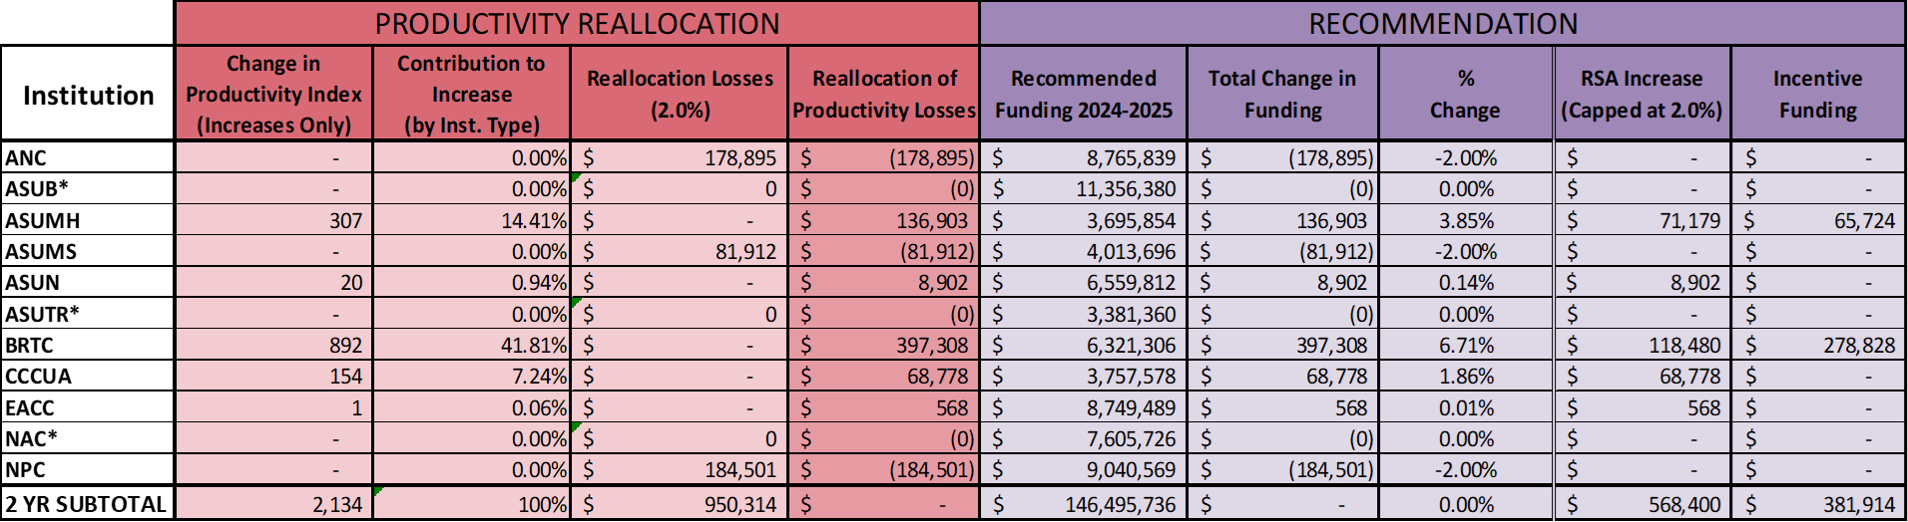
Productivity Funding Distribution
2-Year Colleges

Slide 28
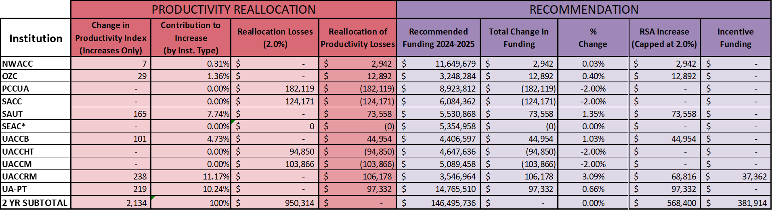
Productivity Funding Distribution
2-Year Colleges

Slide 29
ADHE Productivity Team
Blake Cannon
Chief Analytics Officer
Arkansas Division of Higher Education
blake.cannon@adhe.edu
Sonia Hazelwood
Chief Data Officer
Assistant Commissioner
Arkansas Division of Higher Education
sonia.hazelwood@adhe.edu
Rachel Lewis
AHEIS Program Manager
Arkansas Division of Higher Education
rachel.j.lewis@adhe.edu
Nick Fuller
Assistant Commissioner of Finance
Arkansas Division of Higher Education
nick.fuller@adhe.edu
Mason Campbell
Chief Academics Officer
Assistant Commissioner
Arkansas Division of Higher Education
mason.campbell@adhe.edu
Tracy Harrell
Chief Program Development Officer
Arkansas Division of Higher Education
tracy.harrell@adhe.edu

